Slide 1
Samples of Use Case Analytics
Retail Analytics, Planning & Process Excellence
For Internal Use Only - Confidential

Slide 2







Data analysis tool: Python/R
We use Python and R for model development, which connects to MIS
Model development workflow with Python/R
Python/R environment
MIS
Data
Exploration, pre-processing
Machine learning
Post-processing
Production script
SQL server
User
Procedure to update Python’s library
Create ticket to IT
Download the library
IT will put the library on local
Make sure other related library available
Python/R users and projects
There are currently five active users (7 for Python and 1 for R)
Project highlights
Description | Method | Tool
Bureau-based credit application scorecard | Logistic regression | R
Income estimation for credit application | Linear regression | Python
Predicting takeover risk on pension loan customers | XGBoost | R
Physical card demand forecasting | Holt-Winters Exponential Smoothing | Python
Convert image (ID Card) to structured data | Optical Character Recognition | Python
For Internal Use Only - Confidential
Notes:
Org ganti
OCR

Slide 3





List of Machine Learning Models
We build various machine learning models to standardize approval process & limit determination, improve efficiency in promotional activities, and forecast card demand to improve budgeting accuracy
-
-
-
-
-
-
: Phone
: E-mail
:Sales Person
: Apps
For Internal Use Only - Confidential

Slide 4
List of Machine Learning Models
We build various machine learning models to standardize approval process,& limit determination, improve efficiency in promotional activities, and forecast card demand to improve budgeting efficiency
-
: Phone
: E-mail
:Relationship
Manager
: Mail
: Apps
For Internal Use Only - Confidential

Slide 5
List of Machine Learning Models
We build various machine learning models to standardize approval process,& limit determination, improve efficiency in promotional activities, and forecast card demand to improve budgeting efficiency
: Phone
: E-mail
:Relationship
Manager
: Mail
: Apps
For Internal Use Only - Confidential

Slide 6
Use Case : Chatbot Intent Prediction Phase 1
LOB
Business Action
Customer Experience Center
Model used as checking reference to confirm that the intent generated by chatbot already correct or not. The case when model agree with chatbot reduce the staff load.
Business Case
Business want to reduce staff load when manually checking chatbot intent. They need reference to check the intent with confidence level >= 85, non-button and intent not null. If our model agree with chatbot, no further checking needed.
Outcomes
The model could reduce the load up to 67% (considering the sample check needed). Reflected on Daily Manhour reduced from 94 minutes into 31 minutes.
What we deliver
Model to predict intent based on customer questions.
Manhour decreased by 67%
Sampled on 19% Data. Accuracy : 99,88%
Reference : 99,95%
Average intent count are 1,819 intents per day. Helpfulness Ration reference are 77,75%, while the model is 80,91%
The model is performing better than expected at decreasing checking load.
Assuming staffs could check 20 intents per minute.
For Internal Use Only - Confidential

Slide 7
Sample Use Case : Propensity New Loan Pension
LOB
Business Action
RLB – Pension Business
Model has been used by RM for prioritization strategy since Jul22. Offers are prioritized for decile 1, 2, and 3
Business Case
RLB offers loans not limited to existing debtors but also to pension customers without lending accounts. Profiling with model is needed to find customer with high chance to accept the loan offer.
Outcome
Through the model, the bank can isolate 27% of its eligible customer base with high likelihood to borrow. Prioritized segments are 2.7x more likely to borrow compared to pre-implementation era (2.8% vs 1.0%). This segment contributes 48% of total disbursed loan, which is more efficient when compared to the rest of the base (73% of customer base for 52% of total disbursed loan).
What we deliver
Propensity model – We profiled our existing banking customers (with no loan) by their likelihood to accept a loan offer within the next four months
Model efficiency
Total $ disbursed by decile
Pre-implementation take-up rate: |  |  | 1.0%
Decile | # Leads | # Takers | % Take
01 | 6,336 | 224 | 3.5%
02 | 8,041 | 209 | 2.6%
03 | 8,758 | 210 | 2.4%
04 | 11,319 | 267 | 2.4%
05 | 17,577 | 277 | 1.6%
06 | 8,631 | 62 | 0.7%
07 | 7,925 | 28 | 0.4%
08 | 6,180 | 9 | 0.1%
09 | 5,097 | 10 | 0.2%
10 | 5,479 | 11 | 0.2%
27% of total leads
2.8% take-up rate
73% of total leads
1.1% take-up rate
*) Data as of Sep23 leads
For Internal Use Only - Confidential

Slide 8
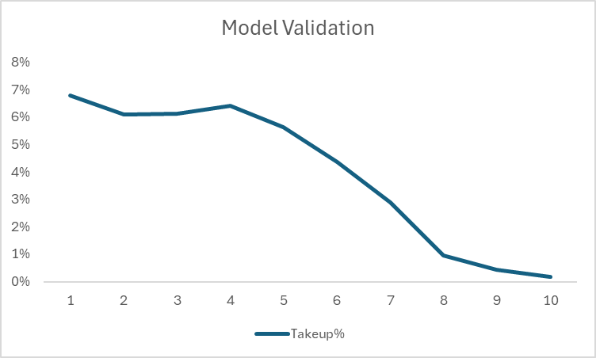
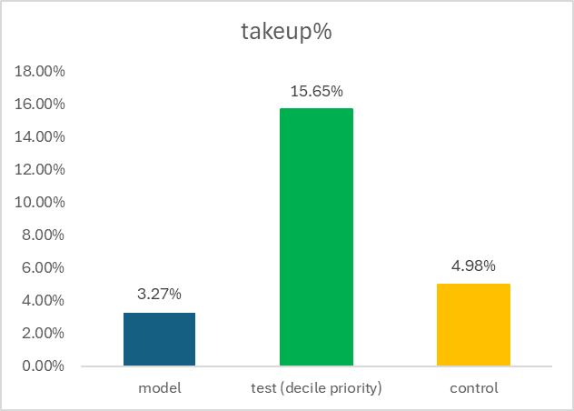
Sample Use Case : Jenius Campaign Credit Card Offer
LOB
Business Action
Jenius – Credit Card
Model use for leads prioritization (decile 1-6) for telesales
Business Case
Outcomes
Business want to prioritizing campaign to approach customer who has intention to apply credit card. In order to improve customers applying for credit card.
In piloting period, take up rate increase significant compared to model validation period to 4.8x.
What we deliver
Propensity Model (CC Apply) to predicted likelihood to apply CC
uplift 4.8x
total takeup% 3.27%
Priority decile 1-6
For Internal Use Only - Confidential

Slide 9
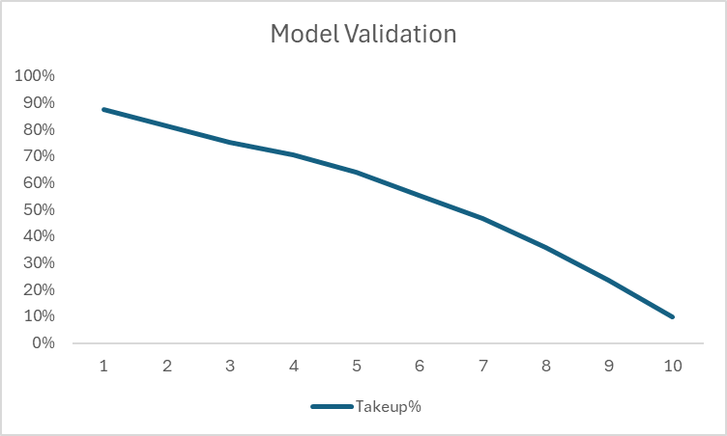
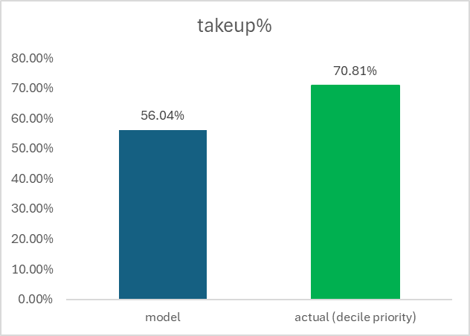
Sample Use Case : Jenius Campaign Flexi Cash Usage
LOB
Business Action
Jenius – Flexi Cash
Model use for leads prioritization (decile 1-5)
Business Case
Outcomes
Business need to increase usage of flexi cash user by offering thru telesales channel. Due to limited resources, need analyse existing flexi cash customer which high probability to disburse.
In acutal period, take up rate increase compared to model validation period to 1.3x.
What we deliver
Propensity model to disburse to predict the likelihood of customer to disburse Flexi Cash
Priority decile 1-5
uplift 1.3x
total takeup% 56%
For Internal Use Only - Confidential

Slide 10
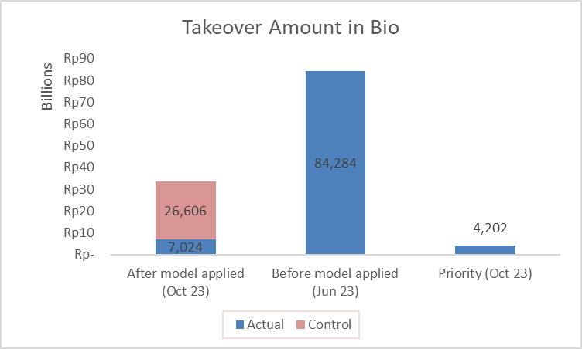
Use Case : Propensity Take Over Loan Pension
LOB
Business Action
RLB – Pension Business
Model are used by RM for for prioritization strategy to reduce takeover rate (has been implemented in Oct23. RM will focus on Decile 1 & 2
Business Case
Several RLB customers are observed to exit their relationship with the bank by having their loan taken over by other financial institutions. The bank manages this risk using takeover score to preemptively retain preferred customers.
Outcomes
Reduces takeover outstanding (amount) from 84,284 billions (before model applied) to 7,024 billions (actual) or 4,202 billions from actual priority decile.
Compared with control group, model can reduce take over amount by 3.8x
60% of takeover amount (actual) came from priority decile.
What we deliver
New takeover score is developed using Extreme Gradient Boosting to predict takeover.
Target :takeover within the next 4 months.
33,629
Priority: Decile 1-2
For Internal Use Only - Confidential

Slide 11
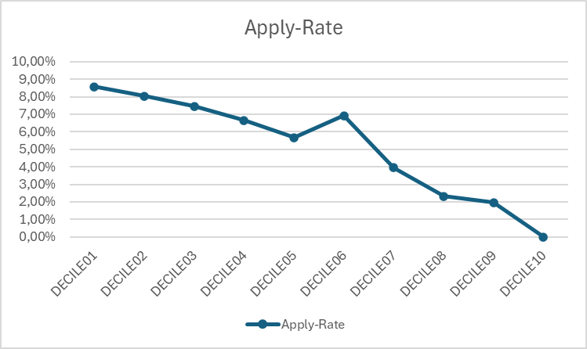
Sample Use Case : FC Model to Apply
LOB
Business Action
Jenius – Flexi Cash
Model used by Telesales for prioritization strategy.
Business Case
Business wanted to offer Jenius customers Flexi Cash product, Offering all Jenius customers will be ineffective for business. Business needs a way to prioritizing customers to apply.
Outcomes
Based on Average attempted call by Telesales, customers in Decile 1-5 are having higher apply rate (6,5%) compared to customers attempted by Telesales.(5,69%).
The uplift on Decile 1-5 is 14,3%.
What we deliver
Propensity model – We profiled our existing banking customers tendency to apply for Flexi Cash. We sorted the customers into 10 deciles based on their propensity to apply, with smallest decile (Decile01) being the best customers to be offered Flexi Cash.
Apply Rate
Apply Rate Details
Decile | Apply | Non-Apply | Total | Apply-Rate | Cum. Apply Rate
DECILE01 | 14 | 153 | 167 | 8,57% | 6,50%
DECILE02 | 30 | 340 | 369 | 8,03%
DECILE03 | 54 | 666 | 720 | 7,45%
DECILE04 | 81 | 1.132 | 1.213 | 6,65%
DECILE05 | 123 | 2.039 | 2.162 | 5,67%
DECILE06 | 142 | 1.906 | 2.047 | 6,92% | 4,86%
DECILE07 | 56 | 1.350 | 1.405 | 3,96%
DECILE08 | 22 | 916 | 937 | 2,31%
DECILE09 | 4 | 183 | 186 | 1,97%
DECILE10 | - | 2 | 2 | 0,00%
Grand Total | 524 | 8.686 | 9.209 | 5,69% | 5,69%
Notes : Data based on Flexi Cash model Dec 2023 – Feb 2024 with customer attempted by telesales 1 month after the model period. The number shown are in average.
*) Data as of Sep23 leads
For Internal Use Only - Confidential

Slide 12
Use Case : Propensity Investment Product
Stakeholder
Business Action
Wealth Management Business
Model are used by RM for prioritization strategy (has been implemented in Mar 2024
Business Case
WMB need to offer Investment Products to all WMB Customer. Profiling or Model is needed to found customer which has high chance to accept the Product offer
Outcomes
Priority Leads produce a higher Takers Rate compared to Control Group by 5.53x (1.18% vs 0.18%) &
Produce higher AUM compared to Control group by 38.8 Bio or 5.99x (45.3 Bio vs 6.48 Bio) with less # of customer (8,394 vs 17,716)
What we deliver
Propensity model – Predict the likelihood of Existing Wealth Customer that don’t have Investment Product to accept the product offer
Target : Accept product offer in the next 3 months
1 Month Performance (Post Implementation)
(0.64%)
(1.36%)
(0.22%)
(0.46%)
(0.83%)
(2.23%)
(0.05%)
(0.29%)
(0.18%)
(1.18%)
** (x.xx%) : Takers Rate
*CG = Control Group

Slide 13
Use Case : WMB Leads 1 Month Performance (Post Implementation)
Stakeholder
Wealth Management Business
Business Action
Business Case
Model are used by RM for prioritization strategy (has been implemented in Mar 2024
WMB need to offer Investment Products to all WMB Customer. Profiling or Model is needed to found customer which has high chance to accept the Product offer
Outcomes
What we deliver
With fewer leads by 53.2%, The Model Leads produce a higher Takers Rate than Control Group by 1.0% or 552.95% uplift &
Produce higher AUM than Control group by 38.8 Bio or 599.27% uplift
The Model Leads produce (AUM , Takers Rate) :
Bonds (45.3 Bio , 1.36%)
BA (610 Mio, 0.46%)
Valas (684.5 Mio, 2.09%)
MF (3.7 Bio, 0.29%)
Propensity model – Predict the likelihood of Existing Wealth Customer that don’t have Investment Product to accept the product offer
Target : Accept product offer in the next 3 months

Slide 14
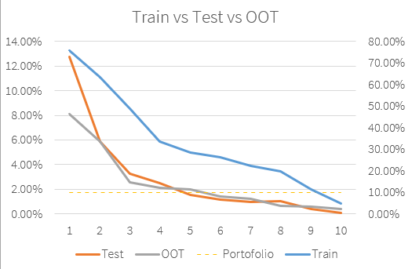
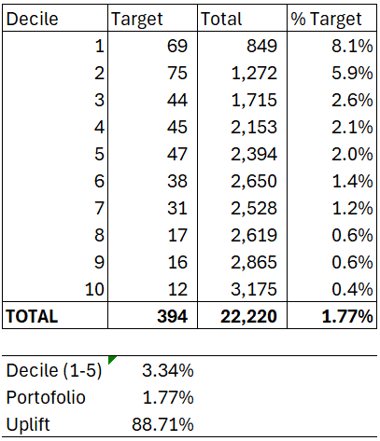
Use Case : WMB Product Leads
Stakeholder
Wealth Management Business
Business Action
Business Case
Model are used by RM for prioritization strategy (has been implemented in Mar 2024), priority offer for Bonds
WMB need to offer Bonds to all WMB Customer. Profiling or Model is needed to found customer which has high chance to accept the Product offer
Outcomes
What we deliver
helps streamline to optimize the potential buyer customer, so the offering process for each product doesn't need to contact all WMB customers, but only the most likely ones
The takers for Bonds chance (decile 1-5) 3.34% is higher than portfolio average (1.77%) or 88.71% uplift
Propensity model – Predict the likelihood of Existing Wealth Customer that don’t have Investment Product to accept the product offer
Target : Accept product offer in the next 3 months

Slide 15
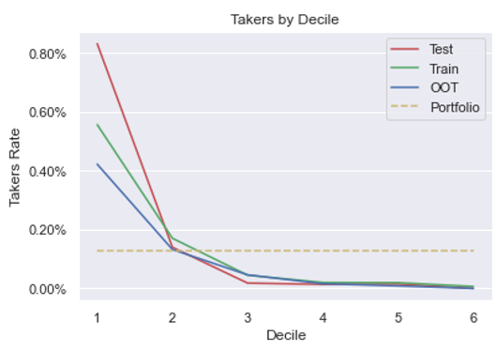
Use Case : WMB Product Leads
Stakeholder
Wealth Management Business
Business Action
Business Case
Model are used by RM for prioritization strategy (has been implemented in Mar 2024), priority offer for MF
WMB need to offer Mutual Fund to all WMB Customer. Profiling or Model is needed to found customer which has high chance to accept the Product offer
Outcomes
What we deliver
helps streamline to optimize the potential buyer customer, so the offering process for each product doesn't need to contact all WMB customers, but only the most likely ones
The takers for MF chance (decile 1-2) 0.27% is higher than portfolio average (0.1%) or 170.56% uplift
Propensity model – Predict the likelihood of Existing Wealth Customer that don’t have Investment Product to accept the product offer
Target : Accept product offer in the next 3 months

Slide 16
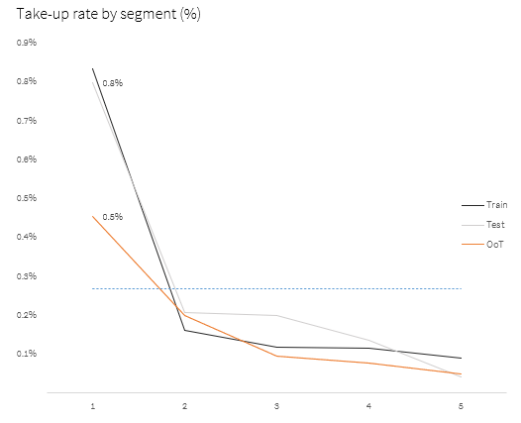
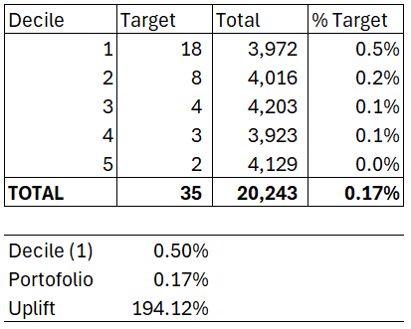
Use Case : WMB Product Leads
Stakeholder
Wealth Management Business
Business Action
Business Case
Model are used by RM for prioritization strategy (has been implemented in Mar 2024), priority offer for Bancassurance
WMB need to offer Bancassurance to all WMB Customer. Profiling or Model is needed to found customer which has high chance to accept the Product offer
Outcomes
What we deliver
helps streamline to optimize the potential buyer customer, so the offering process for each product doesn't need to contact all WMB customers, but only the most likely ones
The takers for BA chance (decile 1) 0.4% is higher than portfolio average (0.17%) or 194.12% uplift
Propensity model – Predict the likelihood of Existing Wealth Customer that don’t have Investment Product to accept the product offer
Target : Accept product offer in the next 3 months

Slide 17
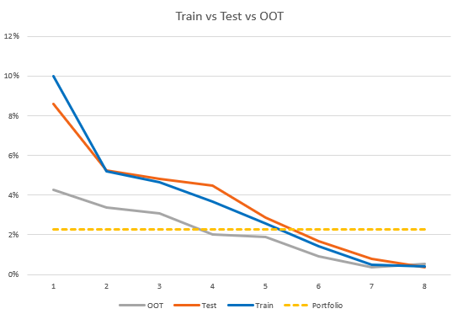
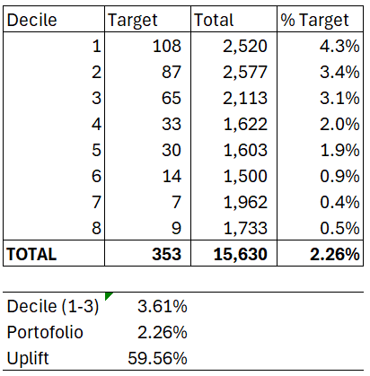
Use Case : WMB Product Leads
Stakeholder
Wealth Management Business
Business Action
Business Case
Model are used by RM for prioritization strategy (has been implemented in Mar 2024), priority offer for Valas
WMB need to offer Valas to all WMB Customer. Profiling or Model is needed to found customer which has high chance to accept the Product offer
Outcomes
What we deliver
helps streamline to optimize the potential buyer customer, so the offering process for each product doesn't need to contact all WMB customers, but only the most likely ones
The takers for Valas chance (decile 1-3) 3.61% is higher than portfolio average (2.26%) or 59.56% uplift
Propensity model – Predict the likelihood of Existing Wealth Customer that don’t have Investment Product to accept the product offer
Target : Accept product offer in the next 3 months

